Slide 1
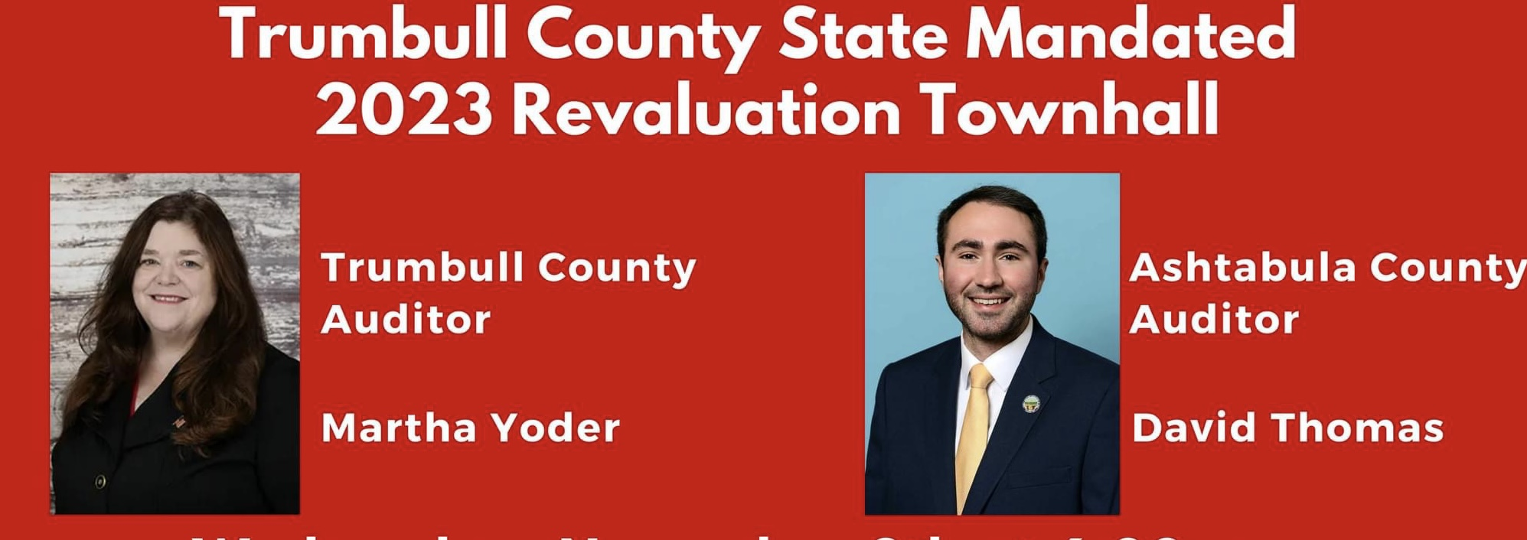

Slide 2
Agenda
2023 State Mandated Six Year Mass Revaluation
What is it? Why is it? When is it? How will it impact me?
Basics of Values, Taxes, Auditor’s Role
2023 Levy Information
2023 State Mandated CAUV Soil Value Update
Why?
Where do I see my change?
What impact will this have on my taxes?
What are my options?

Slide 3
Key Takeaways
Value increases do not equal tax increases dollar for dollar, the tax rate will go down as values go up, but not proportionately.
The Auditor does not raise taxes, the Auditor’s role is to follow the market and update market values or insert CAUV Values.
CAUV is a state program, with a state formula, and state soil types. County Auditors have no discretion except which properties qualify. Value Updates are a state mandate.
Contact the State Legislature to share your concerns, the Auditor’s discretion is limited with a Sexennial and nonexistent with CAUV. Any changes to this process must be made through the State of Ohio in conjunction with Farm Bureau.

Slide 4
How is Value Determined? Mass Appraisal
State Mandated Mass Revaluations & Triennials
Every 6 years we reappraise every parcel on its own merits, all 144,000 of them!
In between reappraisals, we have Triennial Updates
On the 3rd year post reappraisal we update values based on the sales data from the prior 2-3 years.
The State Department of Taxation mandates a % change for the entire county based on sales occurring since the last update.
The Auditor’s role is not to tax, but to follow the market and assign property values based on local market activity.

Slide 5
Six Year Mass Revaluation
Property values based on what a parcel could sell for on January 1, 2023.
The Real Estate Market has grown tremendously since the Triennial in 2020.
We analyze sales neighborhood by neighborhood to determine how the market has changed relative to our previous assigned values.
Update land values, NOT CAUV, and building values as needed to bring the values to an accurate number.
Tax Rates and Amounts are calculated after levies and values are final, will be available end of year.
Property Value updates occur to promote taxation equity.
Opportunity to informally appeal value now-Monday and Tuesday appointments were added today. And we take phone calls with questions.
Formally through Board of Revision Jan 1 – April 1, 2024.

Slide 6
Property Value & Tax Basics
Appraised vs Taxed Value
Appraised value is what the Auditor believes the property will sell for at January 1st of the Tax Year
Taxed value is the value which the tax rate is applied, 35% of appraised value
Tax Rates are expressed in mills
1 mill = $1 of tax for every $1,000 of assessed value
Fixed Rate Levies collect the same amount of revenue year after year, how? Effective rates. A majority of levies are fixed rate. However, schools have 20 mills and local entities 10 mills which is tied to value.
As an example
If your total appraised valuation is $100,000 and you have a 1 mill new levy, your payment would be:
100,000 x 35% x (1/1000) = $35
Appraised Value
Assessed Value Calc.
Millage Calc.

Slide 7
Types of Voted Levies
Outside Millage (Voted)
Renewals
Extend existing levies at the same millage rate.
Ex: 9.25 mill renewal for Mathews Schools original levy date was 2009-the effective rate is 8.000695 mill. The levy passed to renew for 5 years. The mills will not increase due to fixed revenue collection.
Reduced tax liability due to fixed collection
Replacements
Change existing levies’ reduced millage rates back to the full rate. These types of levies increase tax liability.
Ex: 3 mill replacement for LaBrae Schools original levy date was 1984-the effective rate is 1.553763. The levy to replace for 5 years was (tentatively) passed. If it does pass, it will be 3 mills for 5 years beginning tax year 24 payable 25.
Additionals
Generates tax revenue through new levies, raising the total effective rate and increasing tax liability.

Slide 8
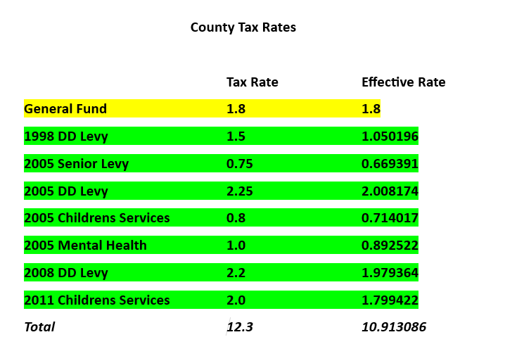

Slide 9
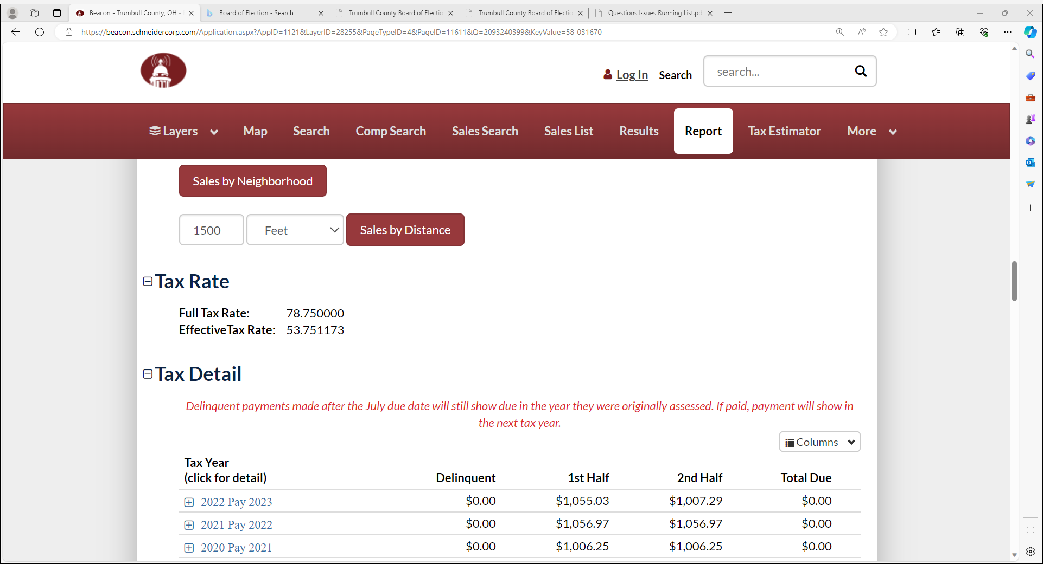

Slide 10
Your possible action steps from the Six Year Mass Revaluations
We have the new tentative values posted on the website and have been doing informal reviews. We have added two more days next week for scheduled reviews.
January 1st - March 31st formally appeal through Board of Revision.
Speak with your mortgage company, set up monthly/quarterly payment plan with the Treasurer.
Make sure you are signed up for Homestead if eligible.

Slide 11
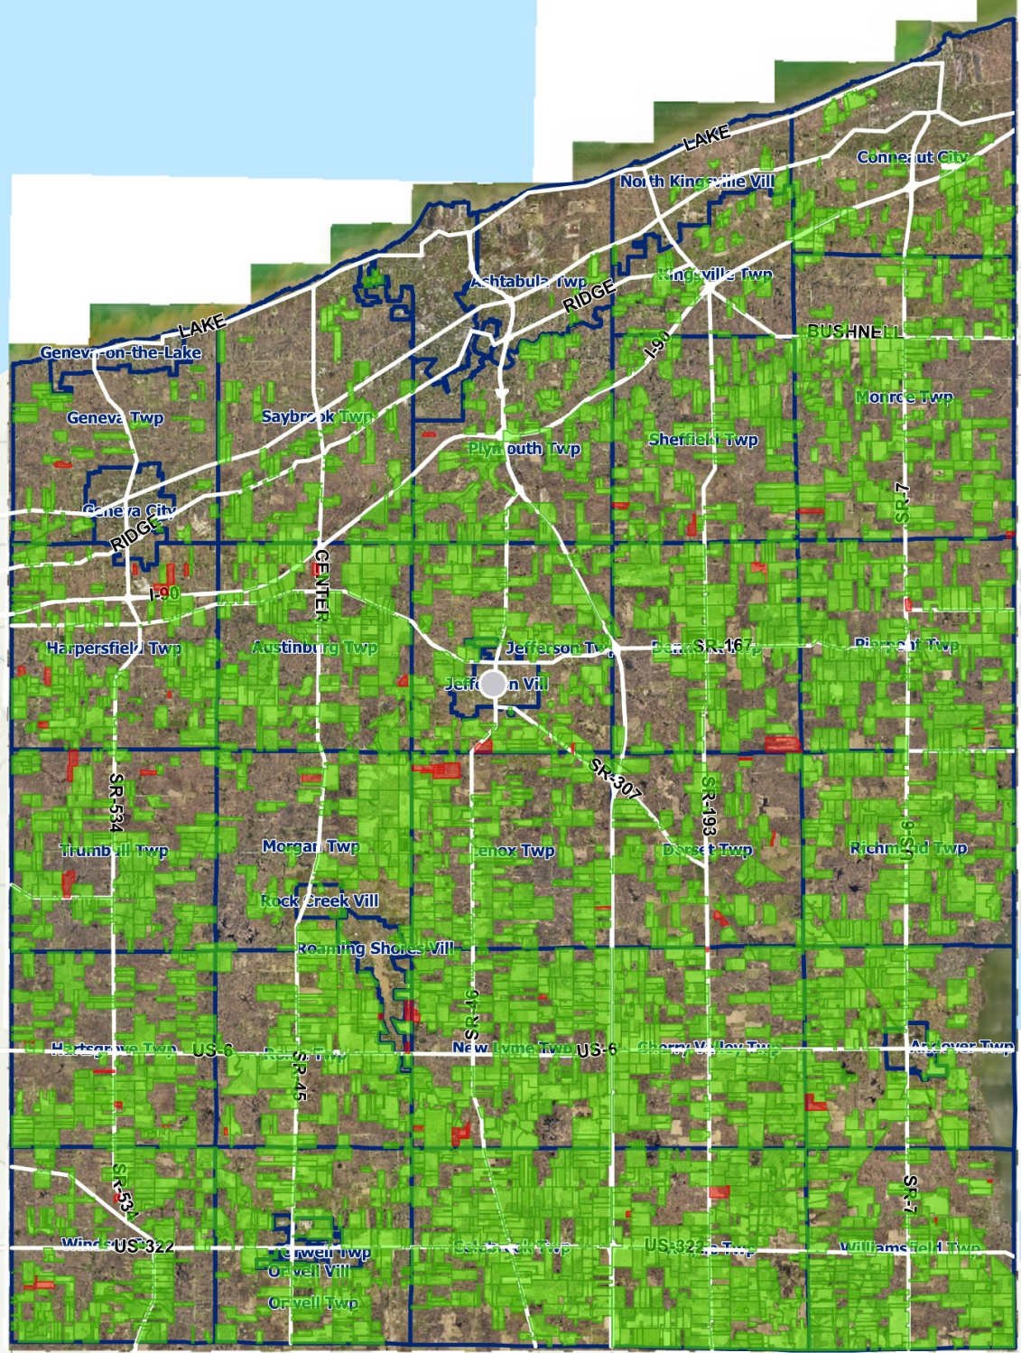
CAUV Soil Types-Why?
2022 CAUV Inspection
The State Department of Taxation has the soil types for all properties in Ohio. Instead of market value for a property- the State assigns a value to the soil beneath your farm.
Trumbull County has over 100 Soil Types with properties having multiple soils beneath your farm.
Example: $5,000 an acre market value vs $400 an acre CAUV soil value.
These values get updated by the State Department of Taxation every 3 years and are assigned to soils.
Notes:
HH

Slide 12
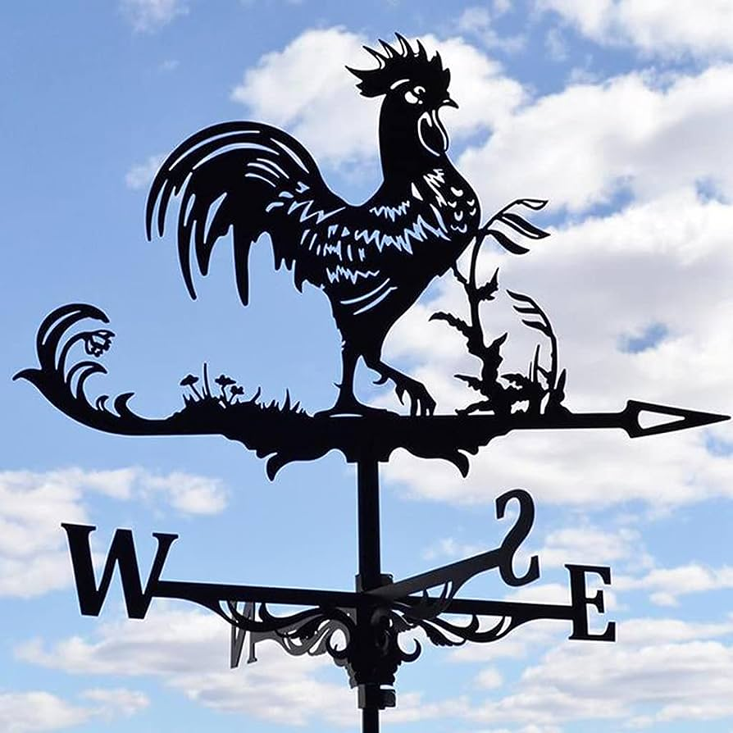
Soil Types-Formula?
The State Department of Taxation uses a formula to determine the values of soil types. This formula was last updated in 2017 and agreed upon by the State Legislature, Dept of Taxation, and Ohio Farm Bureau.
Attempts to mimic the economic status of the average Ohio farm.
Auditors do not have any input in the formula. Our role is administrative- take the values assigned by the Department of Taxation and apply tax rates.
Factors for the formula: Yield Info, Cropping Pattern, Crop Prices, Non-Land Production Costs, Capitalization Rate
Notes:
HH

Slide 13
Formula Factors
Cropping Pattern- based on the acres of corn, beans, and wheat compared to the total acres of crops. Based on statewide averages
Crop Prices- based on survey of prices from elevators in Ohio. 7 year Olympic average
Crop Yields- based on FSA yields per acre for each soil type averaged for Ohio
Non-land Production Costs- based on farmer surveys by The Ohio State University
Capitalization Rate- based on the interest rate for a 15-year fixed mortgage at Farm Credit Services
Notes:
HH

Slide 14
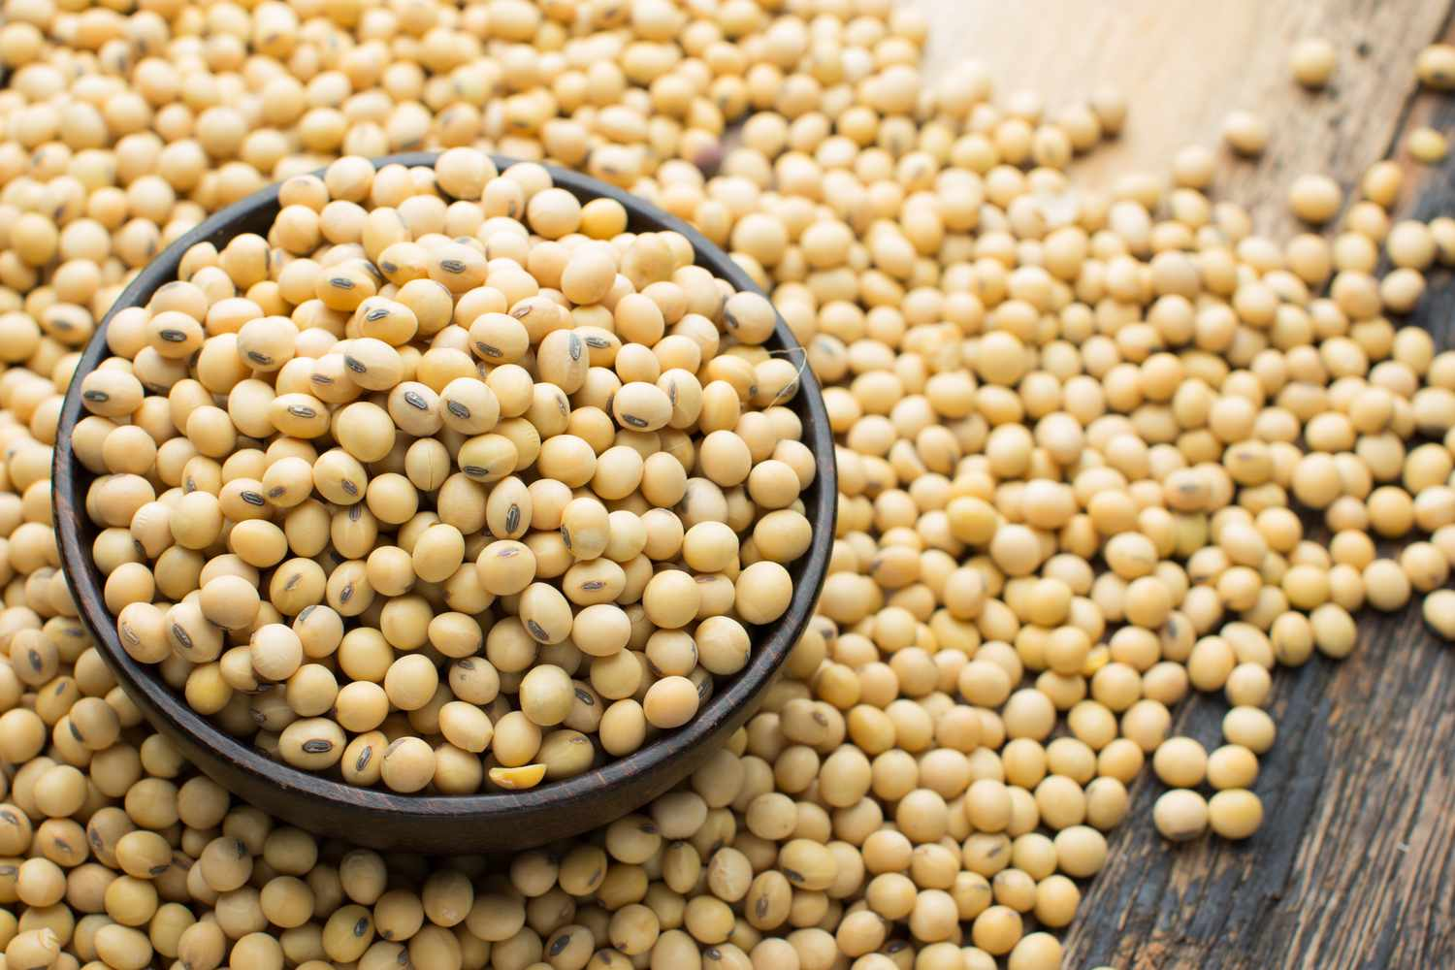
CAUV Formula
Gross Operating Income = Crop Yield x Average Crop Price
Net Operating Income = GOI – Non-land Production Costs
Value = NOI/Capitalization Rate

Slide 15
Your Possible Action Steps?
There is no pathway to appeal a CAUV Value at the county level. The soil value is determined by the State Department of Taxation. Appeal is a legal hearing process through the State Board of Tax Appeals (Adams v. Testa 2017)
CAUV, despite the increase in value, is still a large savings.
You can pull the property out of CAUV, but this will cause recoupment and much higher yearly taxes.
Educate, work through Farm Bureau

Slide 16
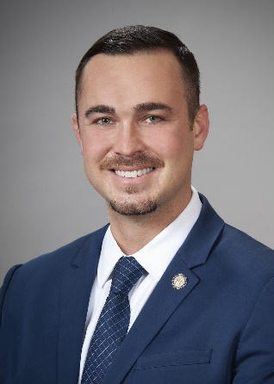
CAUV is a State Program, Can Only be Changed by the State
State Senator Sandra O’Brien
Ashtabula, Geauga, and Trumbull Counties
Office: (614) 466-7182 | www.ohiosenate.gov/sandra-obrien|
State Rep. Nick Santucci
Southern Trumbull
Office: (614) 466-5441| https://ohiohouse.gov/members/nick-santucci|
State Rep. Mike Loychik
South of Rt 90 Ashtabula County, Kingsville & Geneva, Northern Trumbull County
Office: (614) 466-3488 | www.ohiohouse.gov/mike-loychik|

Slide 17
Notes
Notes:
HH

